Slide 1
Pitch Deck
BEHAVIORAL HEALTH ANALYTICS: END-TO-END DATA PIPELINE
Camila Chivelli
DATA ANALYST

Slide 2
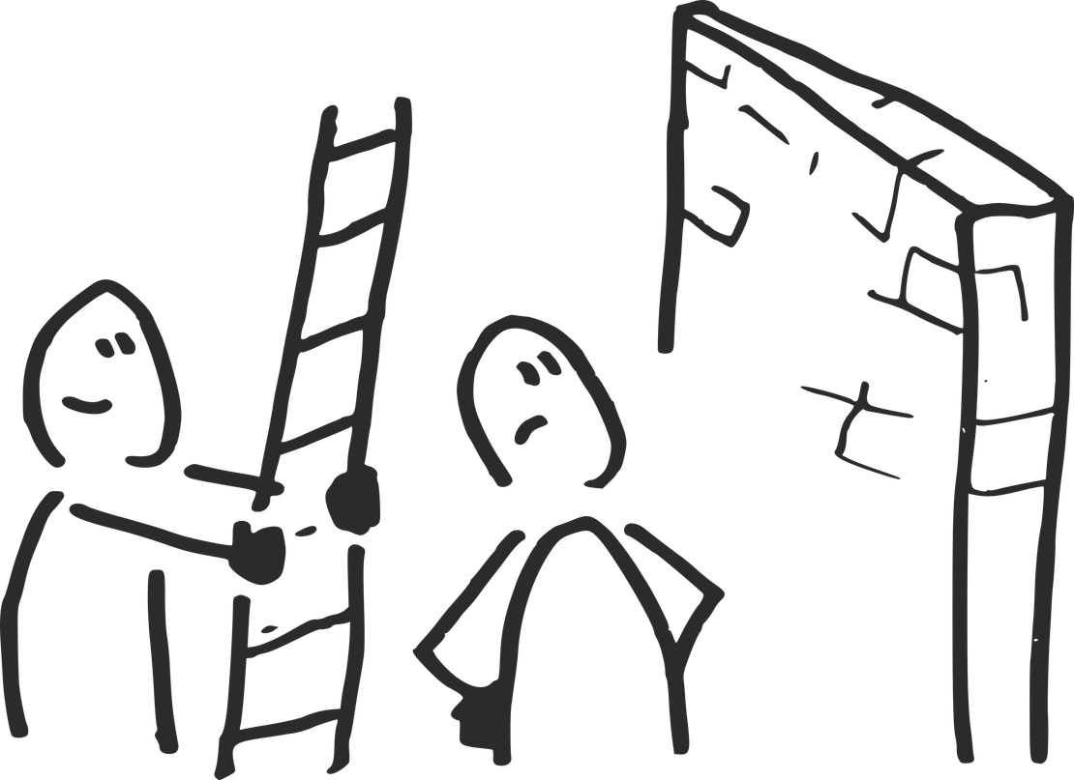


Project Overview
The Problem
Technical Challenge
Objective
Obesity is a multi-factorial health issue. Analyzing it requires cross-referencing dietary habits, physical activity, and genetics without introducing analytical bias.
Processing a hybrid dataset (real + SMOTE synthetic data) containing decimal inconsistencies, potential duplicates, and out-of-range artifacts.
Build an automated Python pipeline to clean the data, validate clinical hypotheses, and segment population archetypes using Unsupervised Learning (K-Means).

Slide 3
Roadmap
Data Cleaning
Machine Learning
Actionable Insights
Managed noise and applied Domain Constraints to guarantee high Data Quality and integrity.
Applied K-Means Clustering and Feature Scaling to create 4 behavioral Archetypes.
EDA & Feature Isolation
Modular Pipeline
Performed EDA and prevented Data Leakage by isolating target variables.
Built a Python Modular Pipeline and Documentation for production.

Slide 4


Data Exploration and Visualization Tools
1
Data Manipulation & Analytics: Pandas, NumPy
2
Machine Learning & Modeling: Scikit-Learn
3
Data Visualization: Matplotlib, Seaborn
4
Environment & Version Control: Python 3.x, Git, GitHub

Slide 5
Data Workflow
INPUT
CLEANING
PROCESS
OUTPUT
Dataset: ~2,100 behavioral health records (real & synthetic SMOTE data).
Features: Biometric, habits, and lifestyle metrics (Age, Weight, FCVC, CH2O, etc.).
Challenge: Multi-dimensional unstructured data with synthetic noise and scale variance.
Quality Control: Applied Domain Constraints and Feature Scaling (StandardScaler).
Feature Engineering: Isolated target variables to strictly prevent Data Leakage.
Modeling: Applied K-Means Clustering (K=4) with Elbow & Silhouette validation.
Architecture: Refactored into a Modular Python Pipeline (main.py).
4 Behavioral Risk Archetypes: Clear population segmentation based on habits.
Production-Ready Repository: Clean codebase, modular structure, and /docs.
Actionable Insights: Data translated into strategic profiles for decision-making.

Slide 6



Key Discoveries & Model Findings
4 Distinct Population Archetypes
Unsupervised K-Means successfully identified 4 clear risk profiles, mapping behavioral habits from baseline healthy lifestyles to multi-factor obesity risk without manual labeling.
Clinical & Domain Alignment
Behavioral risks (sedentary habits, high caloric intake) combine cumulatively. Unsupervised cluster patterns directly aligned with clinical weight categories, validating the model.

Slide 7
What We Found
The End
1
2
3
Targeted Health Interventions
Enables tailored strategy design for specific risk profiles instead of applying one-size-fits-all medical or behavioral approaches.
Early Risk Detection
Categorizes new patient/user profiles instantly based on behavioral habits, predicting health risks prior to severe progression.
Scalable Framework
Built as a modular Python pipeline (main.py), allowing seamless model retraining as new dataset iterations become available.
Key Insight
Data models are only as valuable as their ability to turn complex behavioral variables into clear, scalable decisions.

Slide 8

1
Next Steps & Future Enhancements
Advanced Clustering Models
Benchmark K-Means results against hierarchical or density-based algorithms (e.g., DBSCAN) to analyze cluster boundaries further.
1
Interactive Dashboard
Connect model outputs to Power BI or Streamlit to deliver real-time, visual reporting for non-technical stakeholders.
2
Automated Pipeline Monitoring
Implement data drift checks to continuously audit synthetic data quality and maintain long-term model accuracy.
3

Slide 9
Thank You for Reading!
Full documentation, scripts, and codebase available on GitHub.

